Slide 1


K.RAMAKRISHNAN COLLEGE OF TECHNOLOGY
(AUTONOMOUS), TRICHY.
ALUMNI MANAGEMENT SYSTEM
PRESENTED
SUBIKSEN V S
2303811710421160
SUPERVISOR
Mr.A.MALARMANNAN,M.E,
AP/CSE.
Notes:
1

Slide 2
PRESENTATION OVERVIEW
Objective
Project Introduction
Problem Statement
Methodologies (Programming concepts relevant to problem statement)
Architecture of the proposed system
List of Modules
Merits
Results and Discussion
Queries
Notes:
2

Slide 3
OBJECTIVE
The objective of the Alumni Management System is to provide an efficient and user-friendly platform for managing alumni information, organizing events, sharing job opportunities, and generating data-driven insights. The system aims to strengthen the bond between educational institutions and their alumni by fostering seamless communication, promoting professional networking, and enhancing alumni engagement.Through its comprehensive modules, the system ensures accurate record-keeping, streamlined event management, and effective job postings.
Notes:
3

Slide 4
PROJECT INTRODUCTION
The Alumni Management System is designed to help educational institutions establish and maintain connections with their alumni. It is a comprehensive tool that facilitates networking, career development and event management. By leveraging this system, institutions can strengthen their alumni network and foster engagement that contributes to institutional growth.With an intuitive interface and practical functionalities, this system bridges the gap between institutions and their alumni, enabling mutual growth and collaboration.
Notes:
4

Slide 5
PROBLEM STATEMENT
Inefficient Record Management : Traditional methods of maintaining alumni data are prone to errors, redundancy, and difficulty in retrieval.
Limited Communication and Engagement :Maintaining regular communication and fostering engagement with alumni can be challenging.
Difficulty in Data Analysis and Decision Making : Institutions struggle to analyze alumni data for insights like trends in career growth or event participation.
Notes:
5

Slide 6
METHODOLOGIES
1.Uses ArrayList for dynamic storage of alumni, events, and job
opportunities enabling flexible data management.
2.Implements AWT to provide graphical user interface with
frames,buttons and panel.
3.It uses Event Handling in Lambda expressions and action listeners to
handle user input and interact with the backend logic.
4. Exception handling ensures the program to handle errors like invalid
inputs by creation Custom exception.
Notes:
6

Slide 7
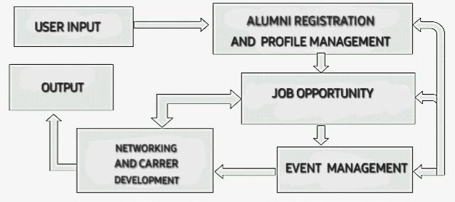
ARCHITECTURE OF THE PROPOSED SYSTEM
Notes:
7

Slide 8
LIST OF MODULES
MODULE DESCRIPTION
Alumni Management Module:
Functions: Adds, displays, updates, and searches alumni information.
Features: Manages alumni personal details such as name, graduation year, contact, and profession.
Event Management Module:
Functions: Adds and displays events organized by the institution.
Features: Handles event details like name, date, and description.
Notes:
8

Slide 9
Job Opportunity Module:
Functions: Adds and displays available job opportunities.
Features: Manages job listings with job title, company name, location, and description.
User Interface & Input Validation Module:
Functions: Provides the user interface for interactions, and validates user inputs.
Features: Handles user choices, prompts for data input, and manages exception handling for invalid inputs.

Slide 10
MERITS
Centralized Data Management
Enhanced Alumni Engagement
Professional Networking
Data Analytics for Insights
User-Friendly Interface
Notes:
10

Slide 11
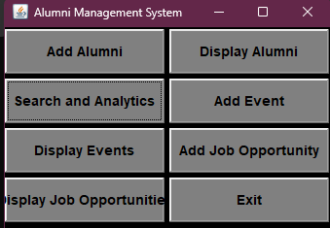
RESULTS AND DISCUSSION
Notes:
11

Slide 12
QUERIES ?
Notes:
12

